Slide 1
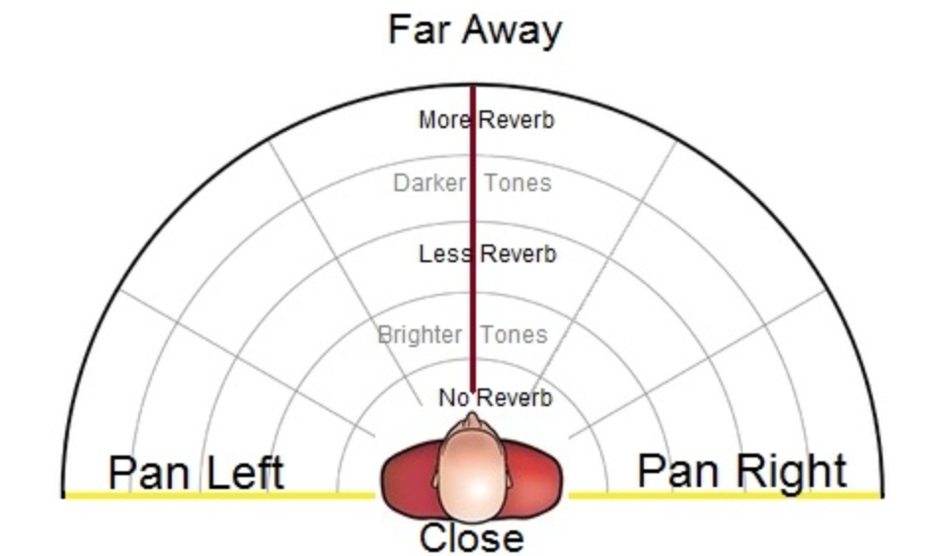
Pan position
Pan position value: where we intend to put our sound source.
Range of 0.0 (fully in left) to 1.0 (fully in right).
Notes:
Panning is the distribution of a sound signal into a new stereo sound field.
When positioning a sound source between two speakers, we have to take care to preserve the sound loudness in each channel.
We can define the pan position value. The value we use, have a range of 0.0 to 1.0, where a pan value of 0.0 puts the sound fully in the left speaker and a pan value of 1.0 puts it fully in the right speaker. A pan value of 0.5 should put the sound in the center of the stereo image.

Slide 2


Linear Panning
Linear panning signal flow
Notes:
Now, We will look at 2 different panning algorithms and hear their differences.
When we have the audio input and pan position value, we can linearly produce the left and right channels by different angles.
Now we can hear the example.
This sound move from the right to the left. So the amplitude of right channel linearly decreased from 1 to 0, the amplitude of left channel linearly increased from 0 to 1.

Slide 3

Square root Panning
Square root panning signal flow
Notes:
Other panning algorithm is square root panning. The difference is, it do not change the sound linearly in signal amplitude, but in signal energy. As we know, signal energy is the square of amplitude, so the sound will retain the same loudness, regardless of the pan position(angle).
In this demo, We implement the panning by linear one to insure the sound change is prominent.

Slide 4
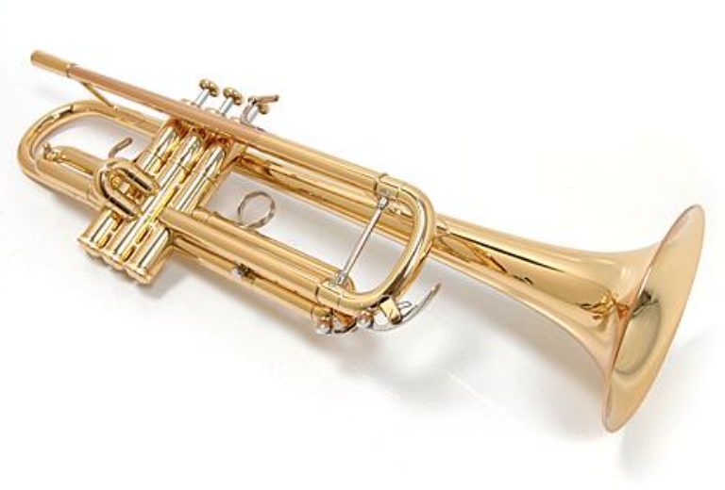


Our Program
Notes:
In our program, we created a drag-and-drop GUI implementing by TkInter. It allows user to drag two instrument sounds to any angle and distance. Then User will hear the mixed sound in real time.

